Slide 1
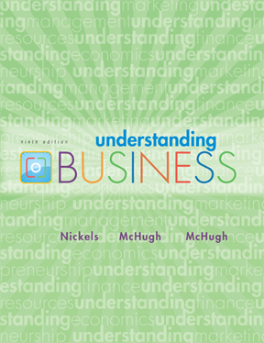
*
Chapter Thirteen
Marketing: Helping Buyers Buy
Speaker:
Tania Akter (TAK)
*
McGraw-Hill/Irwin
Copyright © 2010 by The McGraw-Hill Companies, Inc. All rights reserved.

Slide 2
SEARCHING for INFORMATION
*
Providing Marketers with Information
*
  Test Marketing -- Testing product concepts among potential product users.
  Marketing Research -- Analyzing markets to determine challenges and opportunities, and finding the information needed to make good decisions.
  Research is used to identify products consumers have used in the past and what they want in the future.
  Research uncovers market trends and attitudes held by company insiders and stakeholders.
LG3
13-<number>

Slide 3

COLLECTING SECONDARY RESEARCH DATA
*
Collecting Data
*
LG3
  Secondary Data -- Existing data that has previously been collected by sources like the government.
  Secondary data incurs no expense and is usually easily accessible.
  Secondary data doesn’t always provide all the needed information for marketers.
13-<number>

Slide 4
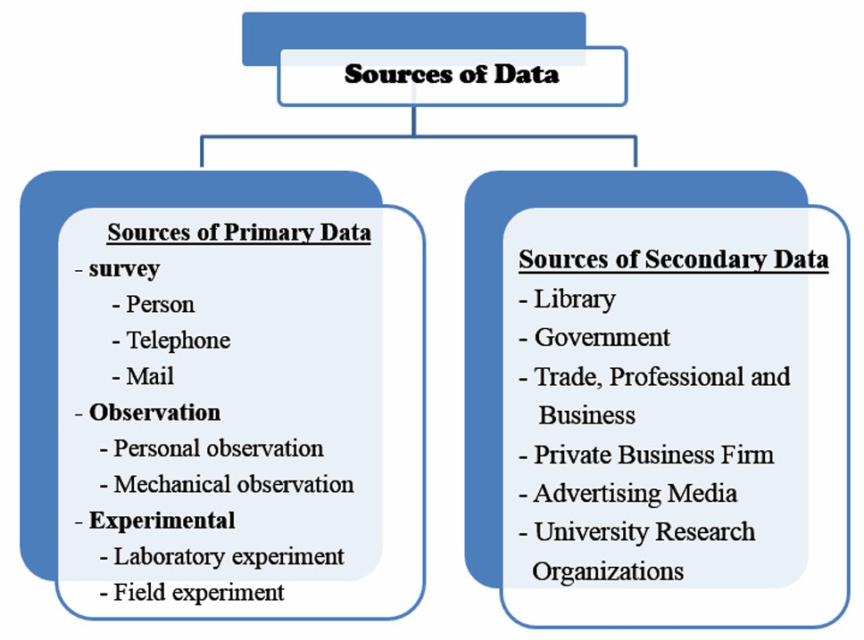
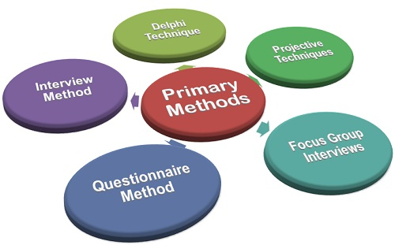
COLLECTING PRIMARY
RESEARCH DATA
*
Collecting Data
*
LG3
  Primary Data -- In-depth information gathered by marketers from their own research.
  Telephone, online and mail surveys, personal interviews, and focus groups are ways to collect primary data.
13-<number>

Slide 5
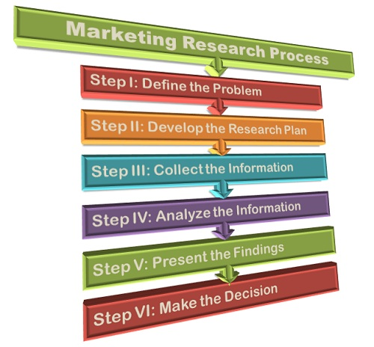
Marketing Research
*
Marketing Research Process
Marketing Research
*
LG3
  Defining the question/problem/opportunity and determining the present situation.
  Developing the research plan
  Collecting research data.
  Analyzing the research data.
  Choosing the best solution
  and implementing it
13-<number>

Slide 6
1. Define the Problem or Opportunity
The most important part of the marketing research process is defining the problem. In order to do any research and collect data, you have to know what you are trying to learn from the research. In marketing research, defining the problem you need to solve will determine what information you need and how you can get that information.
2. After you’ve examined all potential causes of the problem it’s time to build the research plan. To help you develop the research plan, let’s review a few techniques for conducting research:
Interview prospects and customers
Conduct a survey

Slide 7
3. Collect Relevant Data and Information
In marketing research, most of the data you collect will be quantitative (numbers or data) versus qualitative, which is descriptive and observational.
When collecting data, make sure it's valid and unbiased. You should never ask a research interviewee, “You think that we should offer a higher pricing tier with additional services, correct?” This type of question is clearly designed to influence the way the person responds. Try asking both open-ended and closed-ended questions (for instance, a multiple-choice question asking what income range best describes you).

Slide 8

4. Analyze Data and Report Findings
Now that you’ve gathered all of the information you need, it’s time for the fun part: analyzing the data.
5. Put Your Research into Action
Your research is complete. It's time to present your findings and take action. Start developing your marketing strategies and campaigns. Put your findings to the test and get going!

